Slide 1



Newsletter 1
Friday 11th September
Dear Parents/Carers,
Our new school year is underway and it is so lovely to have our Ivy Lane community all together again. Old and new faces have been warmly welcomed and everyone is settling down after our long, hot summer.
Our new Reception cohort are looking very smart in their school uniforms and are adjusting to school life very well indeed. This week they have extended their school day and enjoyed two delicious school dinners in Ivy Hall and a chance to explore the playgrounds.
Staffing-wise, we have welcomed Mrs Allman as a new learning tutor and Mrs Vueti as a new catering assistant.
The focus at the beginning of a new school year for all year groups is always on establishing clear routines and expectations. This gives us a solid base to build on for a successful year of effective learning. We are encouraged to see calm classrooms and respectful movement around school. Ivy Lane behaviour is running through all that we do.
Next week sees the start of our teacher-led after school clubs, the start of school swimming for Year 4 (remember your kit on Monday) and an exciting Reptile Experience for classes in Year 2, 3 and 4. JJ's Reptiles: Exotic Encounters will be visiting Ivy Lane on Monday thanks to the efforts of Mrs Smith and many of our Ivy Lane families and friends who voted for Ivy Lane to win this special experience. We’ll share photos in the next newsletter.
We are delighted that our link with Waterstones bookshop is continuing this year and they will visit us weekly to lead age-appropriate story times for each class in our library. Year 5 classes are up next. This is part of our commitment to encouraging all children to read for pleasure.
Finally, our kitchen staff are to be congratulated on a very successful inspection this week meaning they can display their 5 star hygiene rating with pride. Well done - and thank you for keeping our children happily fed every day.
I wish you all a happy weekend.
Mrs Fahey
Deputy Headteacher

Slide 2


Date | Event
14/09/26 | Reptile Experience for Years 2 to 4
15/09/26 | OPAL Big Build (Volunteers only)
23/09/26 | Individual Pupil Photos
28/09 to 01/10/26 | Bonkers for Conkers Week (see details below)
25/09/26 | Harvest Festival Donations (see poster below)
28/09/26 | Harvest Festival Donations (see poster below)
29 & 30/09/26 | Harvest Festival Assemblies
30/09/26 | Reception Phonics Workshop for Parents 8.45 to 9.30am (Details to follow)
09/10/26 | Hockey Club Quik Sticks Tournament at Sheldon (details to follow)
15/10/26 | FOILS Autumn Discos Y1-Y3: 4.15-5.15pm, Y4-6: 5.30-6.30pm
16/10/26 | Y5 Outdoor Learning (details to follow)
20/10/26 | Open Classrooms 3-5pm
22-30/10/26 | October Half Term
04/11/26 | Student Nasal Flu Vaccinations (details have been emailed)
05-06/11/26 | Y6 Bikeability (Group 1) Details to follow
10/11/26 | Y3 and Y5 Planetarium in school
10/11/26 | Parents’ Evening (3.30-7pm)
12/11/26 | Parents’ Evening (3.20-5.30pm)
17/11/26 | Sunflowers Parents Evening
12-13/11/26 | Y6 Bikeability (Group 2) Details to follow
19-20/11/26 | Y6 Bikeability (Group 3) Details to follow
02/12/26 | Choir to Voices Festival @ Wiltshire Music Festival
09/12/26 | Reception Christmas Nativity 9.30am and 2pm
10/12/26 | Year 2 Christmas Production 9.30am and 2pm
15/12/26 | EYFS / KS1 Christmas Dinner Day
15/12/26 | KS2 Cinema Experience
15/12/26 | KS2 Christmas Parties (no school dinner bookings for KS2)
16/12/26 | KS2 Christmas Dinner Day
16/12/26 | EYFS / KS1 Christmas Parties (no school dinner bookings for EYFS/KS1)
18/12/26 | TD Day
14/01/27 | Y5 to Young Voices (details to follow)
12/02/27 | TD Day
03/03/27 | Y4 Lion King theatre trip (details to follow)
04/03/27 | World Book Day (details to follow)
28/06/27 | TD Day
23/07/27 | TD Day

Slide 3


Sunflower Nursery Places Available for Children Turning 3
Do you have a child turning 3 this year? We'd love to welcome them to our nursery!
Our nursery provides a warm, nurturing environment where children can learn, play, make friends, and develop confidence as they prepare for their next steps into school.
To find out more, parents are invited to book a tour and see our wonderful setting for themselves. Please contact the nursery office to arrange a visit.
If you have friends, family members, or neighbours with children turning 3 this year, please help spread the word and encourage them to get in touch too.
To book a tour, please call the Sunflowers nursery office on 01249 471209 (between 8.30am - 11.30am. We look forward to meeting you!
Bonkers About Conkers 2026!
28th September – 1st October
We are relaunching our ever-popular event,
Bonkers about Conkers, one of Ivy Lane’s renowned
50 Experiences.
Children in Years 1-6 are invited to bring in plenty of
stringed conkers, ready for battle! Class tournaments will
take place on Friday.
How to prepare your conkers: https://www.youtube.com/watch?v=5eXevyBZv_A
How to play: https://www.youtube.com/watch?v=XEAMLWKY9ck
Any donations of extra conkers will be gratefully received in the labelled box near the YR drop off/collection point.
If you are in need of more conkers, please help yourself from this box.

Slide 4

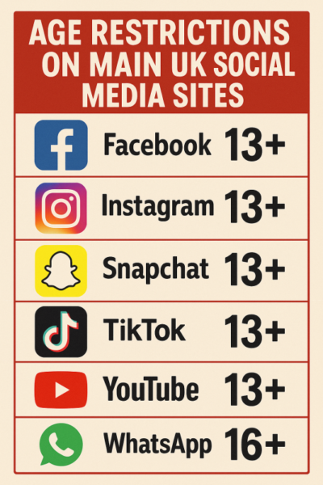
Year Group News
https://www.ivylane.wilts.sch.uk/page/?title=Our+Classes&pid=115
To find out what’s been happening
over the last 2 weeks in your child’s
year group, take a look at the class
pages on our website.
Please note, fortnightly updates will
no longer appear in the newsletter.

Slide 5



Well done to these children who have impressed their class
teachers over the last two weeks.
Donaldson: Niamh R, Nizar H
Hargreaves: Margot N, Arlan B
Dahl: Sophie E, Ted G
Kerr: Madison B, George B
Cowell: Daphne S-L, Dinah M-D
Griffiths: Margot G, Joey B
Morpurgo: Finn D, Sophie G
Zephaniah: Freya L, Charlotte B
Pullman: Dexter H, Bella C
Riddell: Emma H, Evelyn G
Lewis: Summer T, Mia S
Tolkien: Freddie C, Anita Y
Thank you to those who have donated books to their classes
reading corner in celebration of their birthday:
Edward G (Dahl)
Isabella H (Kerr)
Arabella R (Kerr)
Vaishnav T (Cowell)
Adaline W (Cowell)
Orla S-A (Cowell)
Emilia N (Morpurgo)
Darcy G (Pullman)
Evie C (Lewis)
Vishnu T (Tolkien)
Archie P (Tolkien)

Slide 6


Slide 7







Contacting the School
01249 652556
Email Mrs Jones
assistantadmin@ivylane.wilts.sch.uk
Pick up arrangements.
School absences
Medical appointments
School dinner bookings
Wraparound care
Club bookings
Parking permits
Dietary / Medical needs
Email Mrs Nowosielski
admin@ivylane.wilts.sch.uk
For all other enquiries, including admissions, and your first point of contact for any member of staff at Ivy Lane.
Changes to contact details
Please remember to let the school office know if there are any changes to your contact details, addresses, email addresses etc.
Dietary / Medical Needs
Please keep the office updated with any dietary or medical needs your child has. Please let us know if this changed throughout the year.
Medicines
If your child needs to have any medication in school please bring it to the school office and complete a medication form.
Lost Property
Please remember to name your child’s uniform and school equipment.
Particularly their jumpers, cardigans, PE jumpers and water bottles.
You can look for lost items at the end of the school day. Lost property is located inside the Y4/5 entrance near the tunnel gate.
Please remember to let Ivy Kidz know if someone different will be collecting your child. We follow the same procedures as the school and cannot let your child go home with someone different unless we have had authorisation from parents.
A gentle reminder that we cannot accept any late bookings for Ivy Kidz or Breakfast Club due to our staff rota organisation.
Please ensure all sessions are booked within the 1 week booking deadline. Reminders are sent out weekly to advise about dates that the Wrap Around bookings on Arbor will be closing.
A gentle reminder that pick-up times for Ivy Kidz is 5.30pm. Please ensure your child is collected promptly.
Please use the out of hours number to call Ivy Kidz after 3pm for any emergencies or late collections.
Phone: 01249 460822
Email: ivykidz@ivylane.wilts.sch.uk
Please do not call this number during the school day.
If your child is ill, please leave a message on our dedicated absence line, 01249 652556 (Option 1). It really helps us if you leave a voicemail rather than email in.
Please let us know your child’s symptoms rather than saying they are ‘ill’ or ‘sick’ as we require this information for our attendance records.
For absence requests in advance, (eg. appointments / holidays/ external exams) please complete an absence request form, available from the office or download from the website and email in to assistantadmin@ivylane.wilts.sch.uk

Slide 8
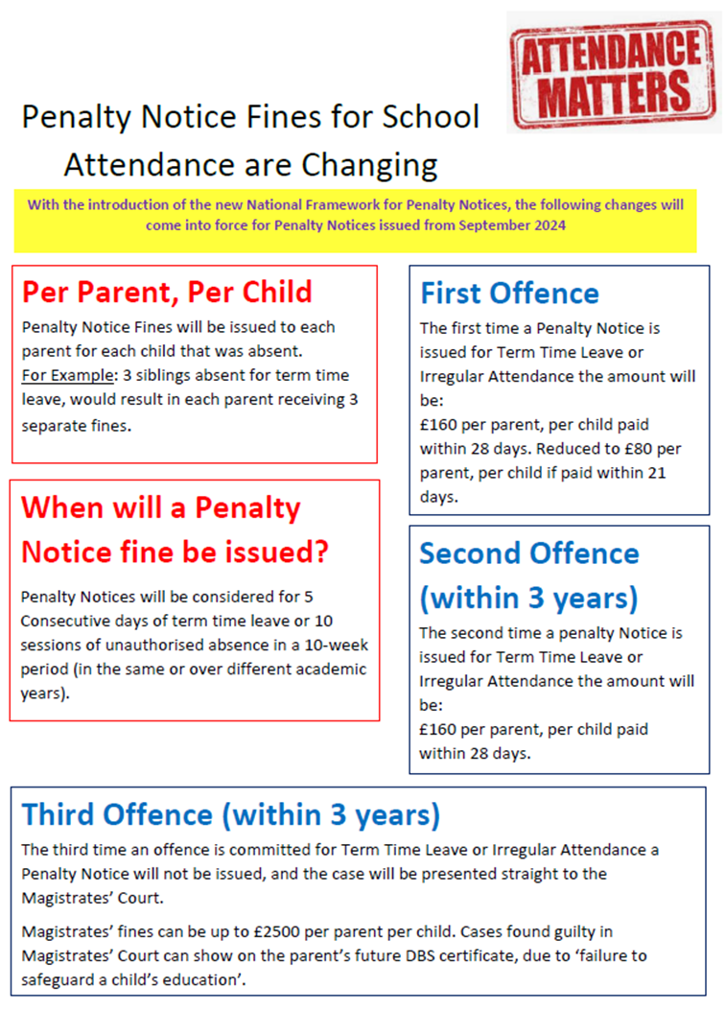

Slide 9





School Uniform can be ordered here:
https://www.mapac.com/education/parents/uniform/ivylaneSN1
WILTSHIRE SUPPORT SERVICES
Wiltshire Parent Carers Council
The Wiltshire Parent Carer Council (WPCC) can provide advice about local sources of support and information for families of children with special educational needs.
Call the WPCC Helpline
01225 764 647
10.00am - 5.00pm
Monday - Friday
https://www.wiltshireparentcarercouncil.co.uk/en/Contact_us
FREE MENTAL HEALTH RESOURCES
Supporting the wellbeing of children has never been so important. To assist you in doing this, SSS Learning Ltd have produced two fantastic free parental resources:
I am sure parents/carers will find these free resources both informative and supportive.
Child Mental Health & Wellbeing - 10 Top Tips for Parents
Parents' Mental Health & Wellbeing - 10 Top Tips for Parents
Wiltshire’s Wellbeing Hub
The Wiltshire Wellbeing Hub can help:
• put people in touch with community groups who can help and provide a warm space
• signpost to sources of financial support and foodbanks
• provide advice to those experiencing loneliness
• advise people on cost-of-living crisis
• signpost customers to any appropriate schemes through the Household Support Fund (HSF)
Part of Pickwick Academy Trust Vision: “to work together to provide the best schools and outcomes for our children “Registered office: Pound Pill, Corsham, Wiltshire, SN13 9YW, Companies House No: 07557894
Web: www.pickwickacademytrust.co.uk Email: admin@pickwickacademytrust.co.uk Twitter: @PickwickTrust

Slide 10


Slide 11


Slide 12


